Slide 1

A MULTILEVEL SECURITY SYSTEM USING STEGANOGRAPHY AND CAPTCHA
Vivekanand Education Society’s
Institute of Technology
(Affiliated to University of Mumbai, Approved by AICTE & Recognized by Govt. of Maharashtra)
Project Guide: Mrs. Smita Jangale
Group Members: Neha Gaikwad
Rhea Makhija
Vinisha Parswani

Slide 2
Introduction
Information security is the collection of technologies, standards, policies and management practices that are applied to information to keep it secure.
When information is not adequately protected, it may be compromised and this is known as an information or security breach. The consequences of an information breach are severe. For businesses, a breach usually entails huge financial penalties, expensive law suits, loss of reputation and business.
For individuals, a breach can lead to identity theft and damage to financial history or credit rating. Recovering from information breaches can take years and the costs are huge.
The purpose of this project is to bring CAPTCHA and steganography together to form a multilevel secure system by combining their features. The objective of the project will be to block unauthorized use, improve security of the hidden message and to maintain the perceptual quality of the image.

Slide 3
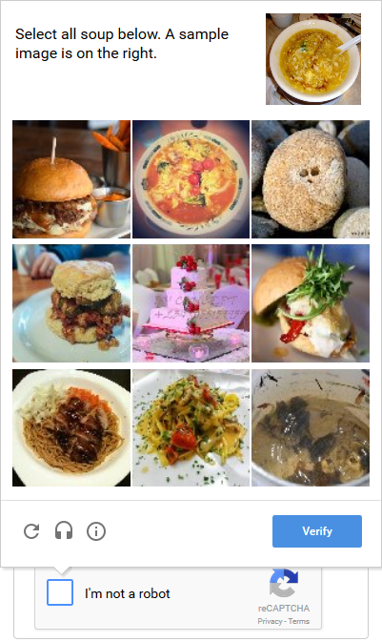
CAPTCHA
A significant number of your users can now attest they are human without having to solve a CAPTCHA. Instead with just a single click they’ll confirm they are not a robot.
reCAPTCHA uses an advanced risk analysis engine and adaptive CAPTCHAs to keep automated software from engaging in abusive activities on your site. It does this while letting your valid users pass through with ease.

Slide 4
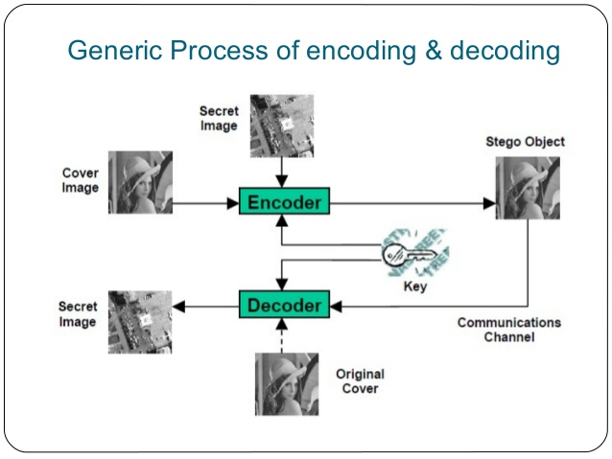
Steganography
Steganography is the act of hiding information in something else.
It is favorable over encryption because encryption only obscures the meaning of the information, steganography hides the very existence of the information, also, encrypted data tends to attract attention, which often proves fatal to any agent.
Using image files as hosts for steganographic messages takes advantage of limited capabilities of human visual system.

Slide 5
Abstract
CAPTCHA is an acronym of the Completely Automated Public Turing test to tell Computers and Humans Apart. CAPTCHA is a technique for ensuring that only those people who pass the test have access and not the system computer generated bots.
In steganography, a message is hidden in such a way that no one apart from the intended recipient knows of the existence of the message.
Steganography is comprised of two algorithms: one for embedding data and one for extraction.
The goal of steganography is to hide information from humans that is accessible to machines. CAPTCHAs have the opposite goal to hide information from machines that is accessible to humans.
The purpose of this project is to bring CAPTCHA and steganography together to form a multilevel secure system by combining their features.
The objective of the project will be to block unauthorized use, improve security of the hidden message and to maintain the perceptual quality of the image.

Slide 6
Problem Definition
Security is an issue of major concern. In today's high technology environment, organisations are becoming more and more dependent on their information systems.
The public is increasingly concerned about the proper use of information, particularly personal data. The threats to information systems from criminals ,terrorists and hackers are increasing.
Thus to ensure a full proof system we are designing and developing a multilevel security system which enables sending of secret message in a secured manner.
To ensure messages are transmitted and received securely, we are developing a security application which will limit the attackers to penetrate their targets.

Slide 7
Proposed System
The application consists of three levels of security
The first level is successfully solving CAPTCHA for accessing the next level
The second level is encryption of the message to be sent
The third level is selecting the image and performing the steganography to hide the message
At the receiving end, the receiver will have to successfully solve the CAPTCHA before separating the message from the image
After separation, the message can be decrypted to retrieve the original message

Slide 8
Block Diagram

Slide 9
Architecture

Slide 10
Flowchart

Slide 11
Comments
The steganography part can be used to hide image messages inside an image instead of text messages inside an image
The image files to be hidden can have a specific size limit and format
Decide the type of Captcha to be used and Steganography algorithm.

Slide 12
Work Done
The application will be able to hide text message along with image message.
It will support various image formats.
The maximum size of the image which can be encrypted is 500 kB.
The Captcha used will be text Captcha.

Slide 13
Literature Survey (1)
Murugan, Sultan, Murali, Suresh, Kumar (March, 2014). “An Efficient and Scalable CAPTCHA Implementation”. www.ijarcsse.com
The people who are using internet may not be aware of what happens behind the closed doors, and more importantly the system/service providers may not be aware of whether human is accessing the service.
So it needs a mechanism that tells the service it is human and not machine (robot) otherwise it needs to stop machines from accessing the service.
This series of questions evolved to the emergence of human verification system. A mechanism that possibly was the answer for all queries comes in name of CAPTCHA.
It was efficient enough but its readability and segmentation are very complex, the former describes user point of view and the latter the system perspective.
We propose a simple to use and easy to manage human verification system that uses letters, digits and symbols to comprise the challenge.

Slide 14
Literature Survey (2)
Khan, Tejaswi, Saini (2011). “Implementation of Steganographic Authentication over Web Applications”. International Conference on Computational Intelligence and Communication Systems.
This paper provides a scheme where the security algorithms of steganography would provide a very high level of security when applied over the web authentication.
The usage of image processing algorithms would provide a very high security as compared to the existing methodologies.
Application of steganography would also be substitute to the biometric & RFID tokens. The authors provide a procedure through which several web attacks can be controlled as brute-force attack, dictionary attack, and password guessing which would make the web applications immune from various hackers.

Slide 15
Literature Survey (3)
Tayel, Hafez, Zied (IEEE 2013). “A New Hybrid Security Allocation Steganography Algorithm”.
Security, authentication, and identification are essential requirement for confidential data transmission. The well known methods of data encryption attain certain security levels, they make the encrypted data unreadable and unnatural this attracts some unintended observer attention.
To search for a higher security approach, Steganography and Cryptography are two popular ways of sending vital information in a secret way. One hides the existence of the message and the other converts the message into an unreadable format.
This paper, describes a method for integrating the advantages of Cryptography and Steganography together through image processing. The paper introduces a New Hybrid Security message Allocation Algorithm (NHSA) to achieve a higher level of security. The statistical evaluation of this system shows that, a higher PSNR and MSE are achieved comparing with the other systems.

Slide 16
Future Scope
The system can be made accessible to be used on mobile phones.
Various types of CAPTCHA can be used.
More levels of security can be included such as biometric passwords, digital signatures, etc.

Slide 17
Thank you

